Slide 1

Introductory Lecture Lecture - Zero
Name of Instructor : Pinky Uniyal
School Name: Uttaranchal Institute Of Technology(UIT)

Slide 2
About the Course
Course Name: PROGRAMMING FOR PROBLEM SOLVING LAB
Course Code: PCS-101
L-T-P Structure: 0-0-2
Weekly Engagement: 2
Course objectives:
To provide the experimental knowledge of basics, structural and procedural programming that examining how to compose a program, moderate program complexity, debug errors by utilizing C language.

Slide 3

Vision of School
To provide quality education, research, training and practical expertise that is stimulating and responsive to the needs of 21st century.
To prepare students to excel in their profession by providing life long learning skills, sound theoretical knowledge, practical experience and all round development.
To stress the importance of a vital sense of moral and ethical values and character building.
To be at the zenith among leading Engineering Institutes in the coming decade and produce technical manpower of international standard and have an all pervasive environment of goodwill and credibility in the society.

Slide 4

Mission of School
To provide learning friendly ambience, developing competence in diversified areas creating excellence in technical arena.
To establish worldwide knowledge integration platforms by developing intellectual capital through research activities.
To establish networks and linkages with industries and academic institutes of National and International importance.
To ensure optimum use of resource through infrastructure sharing, industry interface, faculty and students exchange programs.
To produce ethically and morally strong work – force who would contribute to the development of knowledge economy.

Slide 5

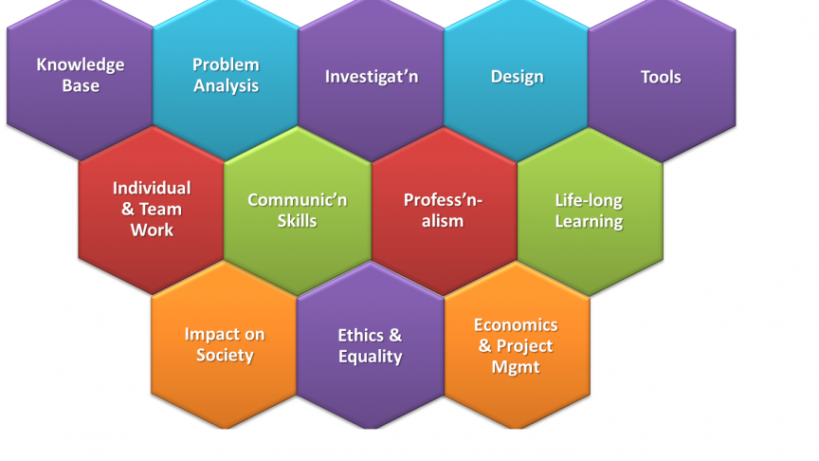
Graduation Attributes

Slide 6

Program Outcomes (Pos)
PO1. Engineering Knowledge: Apply the knowledge of mathematics, science, engineering fundamentals, and an engineering specialization to the solution of complex engineering problems.
PO2. Problem Analysis: Identify, formulate, review research literature, and analyze complex engineering problems reaching substantiated conclusions using first principles of mathematics, natural sciences, and engineering sciences.
PO3. Design/Development of Solutions: Design solutions for complex engineering problems and design system components or processes that meet the specified needs with appropriate consideration for the public health and safety, and the cultural, societal, and environmental considerations
PO4. Conduct Investigations of Complex Problems: Use research-based knowledge and research methods including design of experiments, analysis and interpretation of data, and synthesis of the information to provide valid conclusions.
PO5. Modern Tool Usage: Create, select, and apply appropriate techniques, resources, and modern engineering and IT tools including prediction and modelling to complex engineering activities with an understanding of the limitations.
PO6. The Engineer and Society: Apply reasoning informed by the contextual knowledge to assess societal, health, safety, legal and cultural issues and the consequent responsibilities relevant to the professional engineering practice.

Slide 7

Program Outcomes (POs) ..
PO7. Environment and Sustainability: Understand the impact of the professional engineering solutions in societal and environmental contexts, and demonstrate the knowledge of, and need for sustainable development
PO8. Ethics: Apply ethical principles and commit to professional ethics and responsibilities and norms of the engineering practice.
PO9. Individual and Team Work: Function effectively as an individual, and as a member or leader in diverse teams, and in multidisciplinary settings.
PO10.Communication: Communicate effectively on complex engineering activities with the engineering community and with society at large, such as, being able to comprehend and write effective reports and design documentation, make effective presentations, and give and receive clear instructions.
PO11.Project Management and Finance: Demonstrate knowledge and understanding of the engineering and management principles and apply these to one’s own work, as a member and leader in a team, to manage projects and in multidisciplinary environments.
PO12. Life-long Learning: Recognize the need for, and have the preparation and ability to engage in independent and lifelong learning in the broadest of technological change.

Slide 8

Program Specific Outcome (PSOs)
PSO1. Graduate will attain in depth knowledge and hands on training for different technologies of computer science and engineering as well as information technology.
PSO2. Graduates will effectively exhibit their skills and knowledge as ethical computer engineer with environment sustainability.
PSO3. Graduate will be able to create solutions for real world complex problems in area of computer science and engineering
PSO4. Graduates will be able to create, compare and develop new hardware as well as software technologies using advanced modern tools and languages leading to green and eco-friendly computing

Slide 9
PROGRAMMING FOR PROBLEM SOLVING LAB
A program is a list of instructions or program statements composed in such a way as to enable a computer to solve a problem. The problem to be solved is broken down into successively smaller parts.
Apply algorithmic thinking to understand, define and solve problems 2. Develop computer programs using programing constructs and control structures 3. Decompose a problem into functions to develop modular reusable code.

Slide 10

Course Outcomes
TCS-402.CO1: Build problem-solving solutions based on various C programming techniques.
TCS-402.CO2: Experimental programming with the concept of loop and statements.
TCS-402.CO3: Build the program based on array and functions.
TCS-402.CO4: Apply and evaluate a defensive programming concept.
TCS-402.CO5: Able how to handle the file in c and errors during program execution.

Slide 11

Syllabus of course
Write a Program to display the “Hello” word.
Write a program to calculate the area of Rectangle using user’s input.
Write a program to check weather a given number is even or odd.
Write a program to find the largest of three numbers using nested if else.
Write a program to find whether the given number is Armstrong or not.
Write a program to construct a Fibonacci series up to n terms.
Write a Program to display the “Hello” word.
Write a program to calculate the area of Rectangle using user’s input.
Write a program to check weather a given number is even or odd.
Write a program to find the largest of three numbers using nested if else.
Write a program to find whether the given number is Armstrong or not.
Write a program to construct a Fibonacci series up to n terms.
Write a program to check weather a given number is prime or not.

Slide 12

Syllabus of Course
8. Write a program to print the different pattern.
9. Write a program to sum of the elements of array.
10. Write a program to demonstrate the string functions.
11. Write a program for addition of two matrix.
12. Write a program to find the transpose of a given matrix & check whether it is symmetric or not
13. Write a program to calculate the factorial for given number using recursive function.
14. Write a program printing the elements of structure array using pointers. Write a program to open text file, append and close the file.

Slide 13

Assessment Process (Theory and Practical)
Mid Term: 30Marks
Assignment : 10 Marks
Teacher Assessment: 10 Marks
External: 60 Marks

Slide 14
Suggested Reading Materials
Lab Manual and related Documents

Slide 15

Attendance Requirement
Attendance Required for appearing in examination
(Sessional and End Term): 75 %

Slide 16
Feedback System
Feedback enables a teacher to see how teaching practice can be improved, and which teaching and learning strategies are more likely to be effective.
At Uttaranchal University Daily feedback is given by students on per day lectures also, faculty and student feedback is given in End of the semesters in order to make changes in curriculum/courses(if required).

Slide 17
Important Instructions Do and Don’t
Dress code should be properly followed by each and every students with Id cards.
Be regular in classes and on time .
Cell phone should be in completely off, during the class time.
Given Assignments mandatory to submit on time.
Be Attentive during the Class time, Class performance will reflect the Teacher assessment marks for all.
Maintain the decorum of class.

Slide 18
Thank you!

